Slide 1
Expanding Evolutionary Theory with Learning Theory: Implications for the evolution of development and evolvability
Richard Watson, Loizos Kounios, Kostas Kouvaris J Clune, GP Wagner, DM Weinreich, M Brede, M Pavlicev, R Mills
Institute for Life Sciences/ Institute for Complex Systems Simulation,
University of Southampton, UK.
raw@ecs.soton.ac.uk
Notes:
Please use the dd month yyyy format for the date for example 11 January 2008. The main title can be one or two lines long.

Slide 2
Evolution and Learning
(Paradox of) Evolvability
Equivalence of evolution and Learning
Memory
Generalisation
Learning (increased evolvability)

Slide 3
"Understanding the evolution of evolvability using the theory of memory, learning and generalisation"
In order for evolution by natural selection to explain the adaptation that we observe in natural populations we must account for the availability of suitable variations that natural selection can act on. Rupert Riedl, an early pioneer of evolutionary developmental biology, suggested that this is facilitated by a specific developmental organisation that is itself a product of past selection. However, the construction of a theoretical framework to formalise such ‘evolution of evolvability’ has been continually frustrated by the indisputable fact that natural selection cannot favour structures for benefits they have not yet produced. Here we resolve this problem. Recent work shows that short-term selective pressures on gene interactions are functionally equivalent to a simple type of associative learning, well-understood in neural network research. This is important for the evolution of evolvability because this type of learning system can clearly change in a way that improves its performance on future test cases, i.e., before it has been exposed to those cases, without the need for the future to cause the past. Recognising a formal link with the conditions that enable such predictive generalisation in learning systems unlocks well-established theory to apply to understanding the evolution of evolvability. Here we use this to elucidate, and demonstrate for the first time, conditions where short-term selective pressures (producing the organisation that Riedl suggested) alter evolutionary trajectories in a manner that systematically improves long-term evolutionary outcomes. More generally, we discuss and demonstrate how learning theory can be converted to the evolutionary domain to demystify theoretical problems in evo-devo, evo-eco and the major evolutionary transitions.

Slide 4
Phenotypic distributions and Evolvability
The path of evolutionary trajectories and the possibility of biological adaptation is strongly affected by developmental biases and constraints accumulated over the evolutionary past
One phenotypic distribution may afford adaptation in some environment where another does not - and phenotypic distributions are controlled by the details of developmental processes which are themselves evolved
Thus past evolution could adapt the distribution of phenotypes explored by future natural selection to generate more promising variations and avoid less useful ones – predisposed to exhibit effective adaptation

Slide 5
Foresight and the Paradox of Evolvability
Selection for characteristics that enable future innovation seems paradoxical:
natural selection cannot favour structures for benefits they have not yet produced, and
favouring characteristics for benefits that have already been produced does not constitute future innovation.

Slide 6
Learning theory meets evolvability
A learning system is a system that improves its ability at some task with experience. i.e. it has a behaviour, and it improves that behaviour.
Learning systems that merely repeat behaviours that were rewarded in the past are trivial. More interesting are learning systems that generalise – i.e. produce behaviours that anticipate which actions will confer positive rewards in previously unseen situations. This is not magic.
Could learning theory help us understand how evolution could (act like) it anticipates what is needed in novel selective environments – the evolution of evolvability?

Slide 7
Learning & evolution play by the same ‘rules’
Learning systems, like natural selection, cannot really ‘see the future’. They cannot learn from benefits that have not yet occurred. But they can generalise from past experience.
Generalisation from training set to previously unseen novel test cases is neither mysterious nor for granted – and it can be more than simple extrapolation
Since generalisation in learning systems only requires incrementally improving the fit of a model to data – maybe evolution could do that too. And we could use what we know about conditions for good generalisation to understand conditions for evolution of evolvability

Slide 8
Outline
How can ‘constraints’ make things more evolvable?
1. Can evolution of constraints and biases cause development to be predisposed to recreate multiple distinct phenotypes that have been selected for in the past?
2. Can it generate novel phenotypes from the same structural class – e.g. new combinations of features?
3. Can it use this to evolve better… to generate novel phenotypes that are more likely to be fit → facilitated variation

Slide 9
Outline
How can ‘constraints’ make things more evolvable?
What kind of bias/constraint could development place on phenotypic distributions?
How to model constraints and biases.

Slide 10
How do offspring differ from parents?
Default: Undirected genetic variation -> undirected phenotypic variation
How much?
Trait y
Trait x
Given the option, selection nearly always turns off variation (J. Clune et al., PRSB, 2013)

Slide 11
Uniform genetic variation –> non-uniform phenotypic variation
E.g. More variation on some dimensions, less on other dimensions
As before, selection turns off variation on as many dimensions as its allowed to

Slide 12
Patterns of phenotypic variation (rather than amounts)?
E.g. phenotypic correlations
That’s more interesting because theres potential to constrain/bias variation without just turning it off (in any dimensions)

Slide 13
Pavlicev, M., Cheverud, J. M., & Wagner, G. P. (2011). Evolution of adaptive phenotypic variation patterns by direct selection for evolvability. PRSB, 278(1713), 1903-1912.
Evolution of a modifier locus that alters the correlation between two other traits
Selection aligns variation with the direction of selection
variation that is directed wrt fitness effects
Goes uphill faster – does what its already doing faster – not really any new phenotypes

Slide 14
Pavlicev, M., Cheverud, J. M., & Wagner, G. P. (2011). Evolution of adaptive phenotypic variation patterns by direct selection for evolvability. PRSB, 278(1713), 1903-1912.
Evolution of a modifier locus that alters the correlation between two other traits
Selection aligns variation with the direction of selection
variation that is directed wrt fitness effects
Goes uphill faster – does what its already doing faster – not really any new phenotypes

Slide 15
a linear model of correlations
Feed-forward gene-network
Value of X is sensitive to context of y
Value of Y is sensitive to context of x
genes
traits
x
Wxx
X
genetic inheritance
input
Wxy
Phenotype
output
y
Wyx
Y
Wyy
Pleiotropic interaction matrix

Slide 16
Linear correlation models cant do multi-modal distributions.
Non-linear mappings can
producing two different phenotypes that differ in many traits ‘simultaneously’. e.g. produces petals and sepals but not mixtures in between (XOR)

Slide 17
Non-linear model
Recurrent gene-regulation network (GRN)
Value of x(t+1)is sensitive to context of y(t)
Wxx
Value of y(t+1) is sensitive to context of x(t)
x
Embryonic phenotype (t=0)
Wxy
Adult Phenotype
(t=10)
y
Wyx
Wyy
Gene-regulation interaction matrix
initial gene expression levels unfold over time into adult gene expression levels
We will evolve the connection matrix
A multi-layer FF network (rather than recurrent) would also work

Slide 18
Outline
1. Can evolution of constraints and biases cause development to be predisposed to recreate multiple distinct phenotypes that have been selected for in the past?
2. Can it generate novel phenotypes from the same structural class – e.g. new combinations of features?
3. Can it use this to evolve better… to generate novel phenotypes that are more likely to be fit → facilitated variation
memory
generalisation
learning

Slide 19
1: memory
Watson, R. A., Wagner, G. P., Pavlicev, M., Weinreich, D. M., & Mills, R. (2014). The evolution of phenotypic correlations and ‘developmental memory’. Evolution.
a single GRN can be ‘programmed’ by past selection to ‘remember’ multiple phenotypes

Slide 20
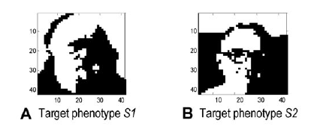
Two different phenotypes (gene expression patterns) selected for in different environments
Selecting for regulatory connections that output the selected phenotype pattern

Slide 21
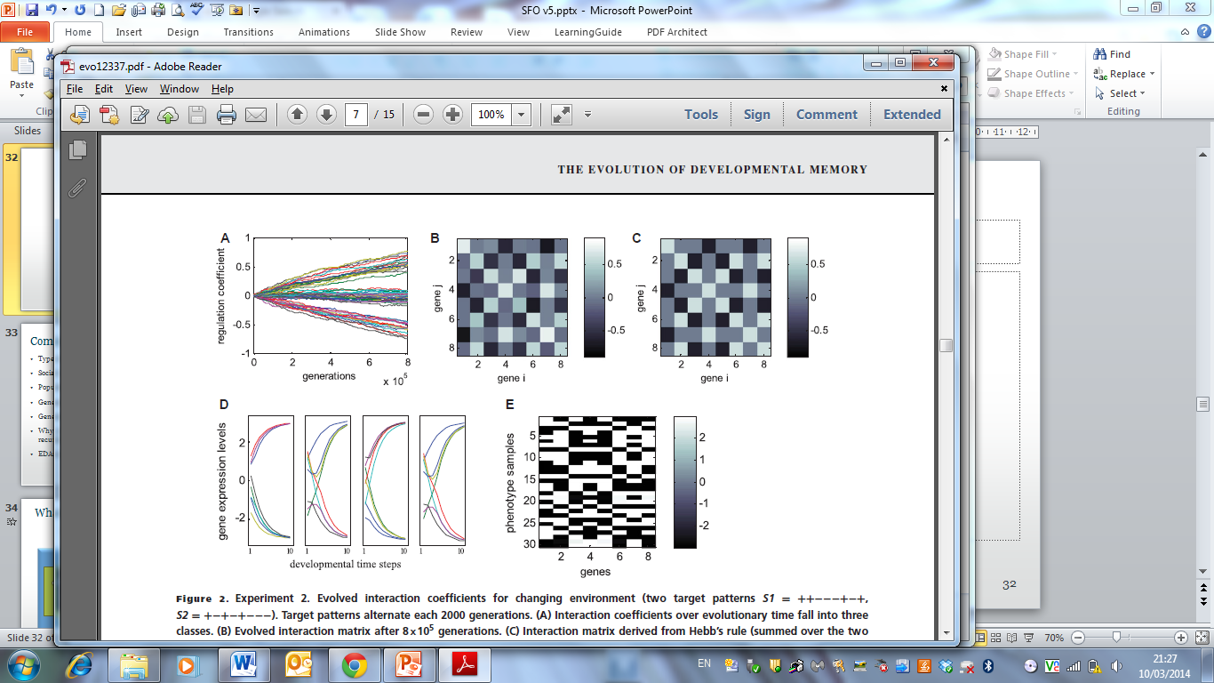
Two different phenotypes (gene expression patterns) selected for in different environments
Selecting for regulatory connections that output the selected phenotype pattern
Evolved regulatory interactions accurately capture trait correlations in selected phenotypes
gene-regulatory interaction strengths change over evolutionary time
evolved regulation matrix

Slide 22
Two different phenotypes (gene expression patterns) selected for in different environments
Selecting for regulatory connections that output the selected phenotype pattern
Evolved regulatory interactions accurately capture trait correlations in selected phenotypes
gene-regulatory interaction strengths change over evolutionary time
matrix learned with Hebbian learning from same two phenotype patterns
evolved regulation matrix
Genes that are selected together wire together

Slide 23
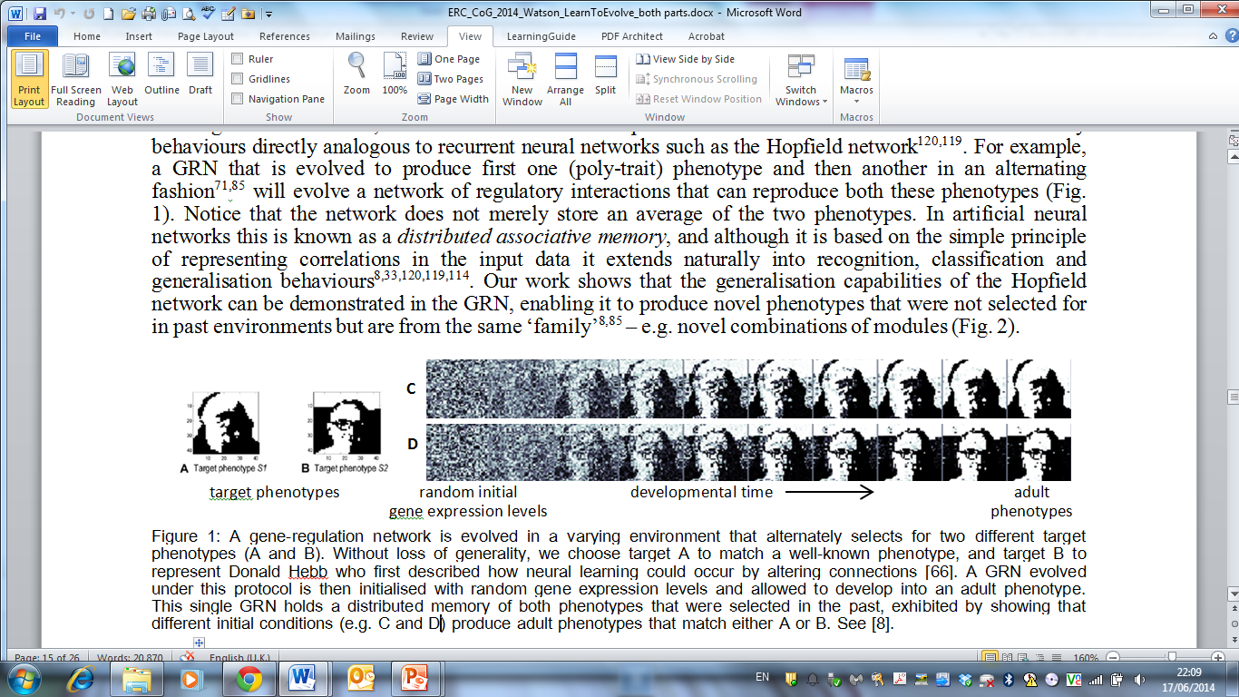
Produces developmental memories:
Evolved regulatory interactions create developmental attractors that correspond to previously selected phenotypes
Single gene network can remember more than one phenotype. G-P map literally is a memory of solutions to past selective environments.

Slide 24
Produces developmental memories:
Evolved regulatory interactions create developmental attractors that correspond to previously selected phenotypes
Single gene network can remember more than one phenotype. G-P map literally is a memory of solutions to past selective environments.

Slide 25
Produces developmental memories:
Evolved regulatory interactions create developmental attractors that correspond to previously selected phenotypes
Single gene network can remember more than one phenotype. G-P map literally is a memory of solutions to past selective environments.

Slide 26
Produces developmental memories:
Evolved regulatory interactions create developmental attractors that correspond to previously selected phenotypes
Single gene network can remember more than one phenotype. G-P map literally is a memory of solutions to past selective environments.

Slide 27
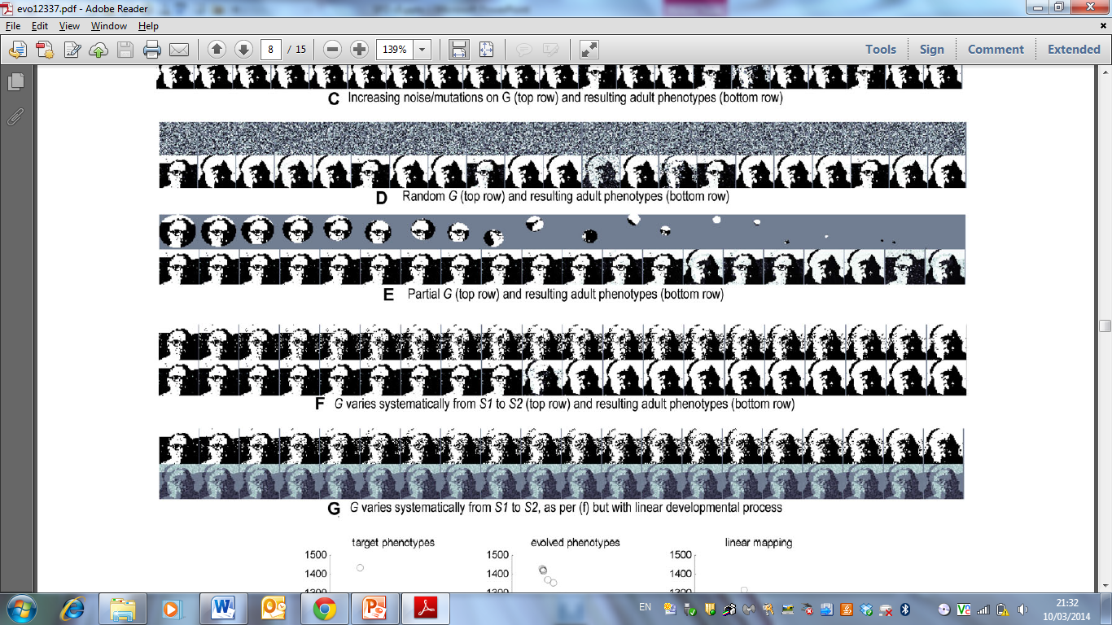
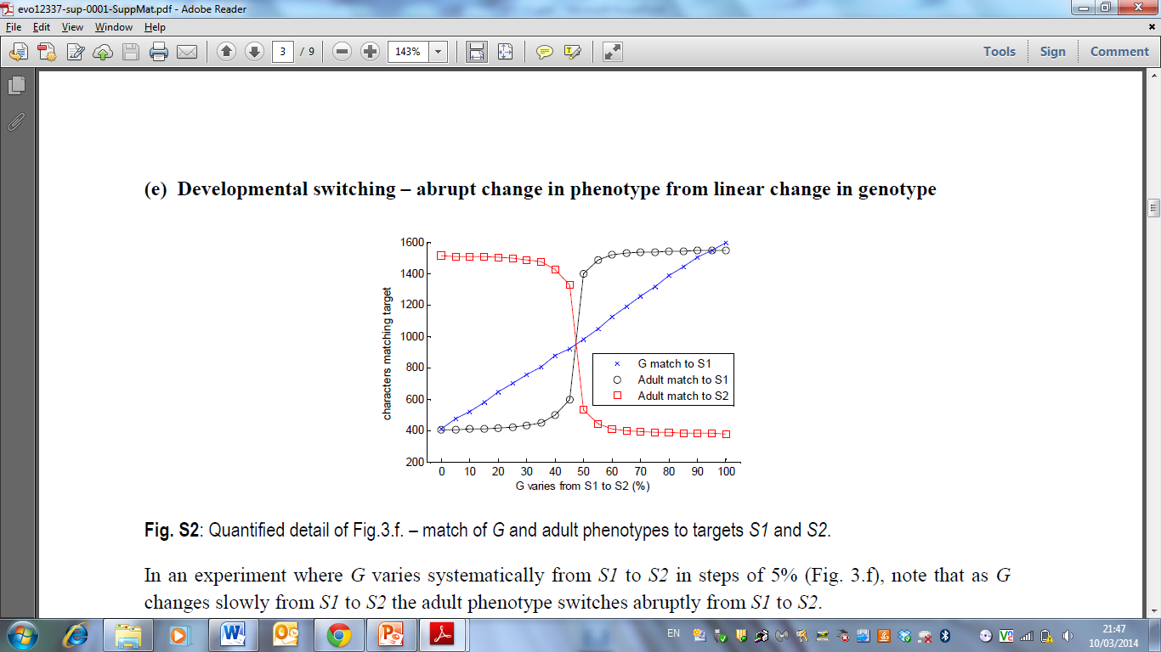
Linear change in embryonic phenotype
Produces highly non-linear change in adult phenotype
4. aka ‘recognition’ or ‘categorical perception’

Slide 28
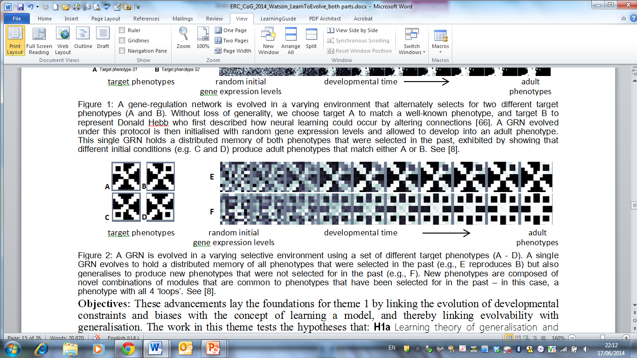
5. generalisation: Development can produce novel phenotypes that are new combinations of learned ‘features’

Slide 29
Conclusions part 1 (of 3)
The effect of natural selection, acting on heritable variation in the parameters of a developmental process, is functionally equivalent to associative (a.k.a. correlation) learning.
In variable environments (=more than one pattern in the training set) this has the effect of producing a distributed memory of phenotypes that have been fit in the past – making them easily re-producible, even if they are far apart in phenotype space.

Slide 30
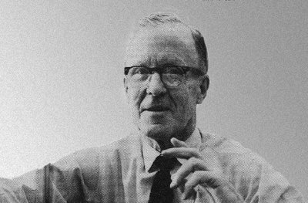
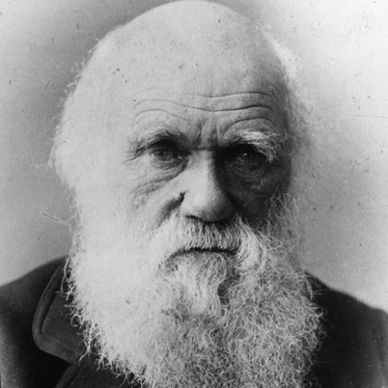
Learning /Evolution
Donald Hebb
isomorphism
learning rules to exploit correlations
≡
selective pressures on evolved correlations
?
(Watson et al, 2010, 2011a,b, 2012 – Artificial Life, Adaptive Behaviour, Complexity, Evolution)
learning/memory, generalisation, categorical perception/recognition constraint optimisation
learning/memory, generalisation, categorical perception/recognition and constraint optimisation

Slide 31
2. generalisation.
Kostas Kouvaris
Can an evolved GRN produce phenotypes that were not selected for in the past?
But are structurally similar to phenotypes that were selected in the past
E.g. learn what ‘well formed features’ look like, and then make new combinations of these features
Kouvaris, K., Clune, J., Kounios, L., Brede, M. Watson, R.A. (2015) How Evolution Learns to Generalise: Principles of under-fitting, over-fitting and induction in the evolution of developmental organisation. (arXiv:1508.06854).

Slide 32
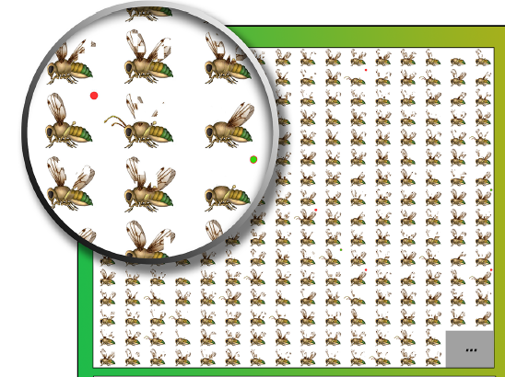

Slide 33
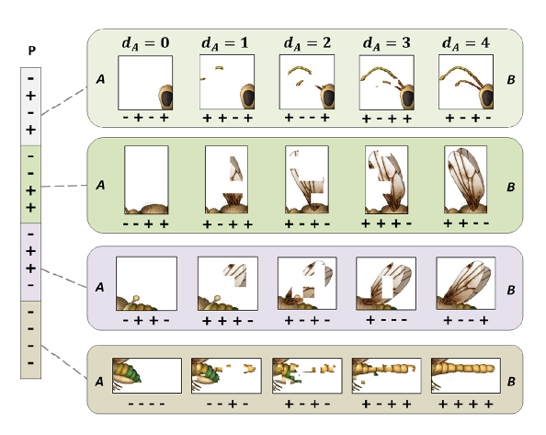
Pictorialisation: 4 features, each controlled with 4 genes

Slide 34
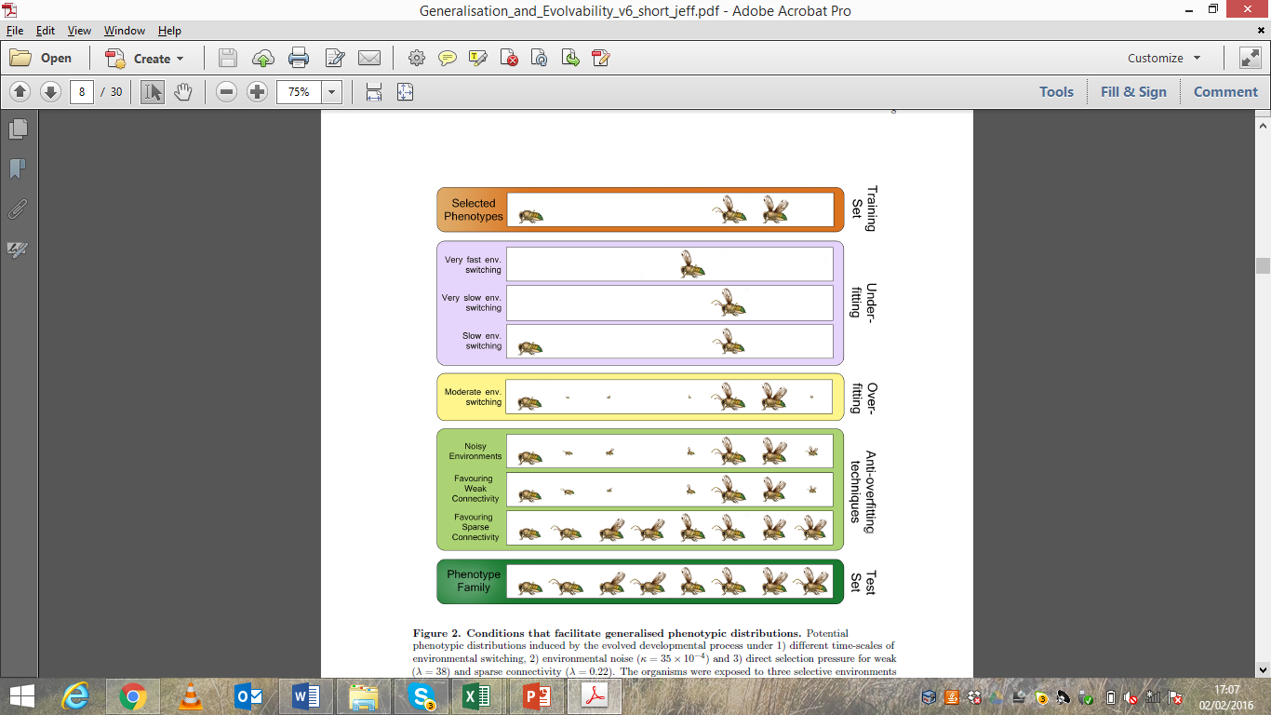

Slide 36
failure to generalise: Overfitting
In machine learning the tendency to learn the specific patterns that were rewarded in the past, but to fail to learn the general class of patterns, is known as overfitting.
In learning models, we know something about conditions that alleviate overfitting – e.g. when there is a parsimony pressure for simple/compact models.
An easy way to do this is to favour networks that learn the training patterns using less connections – encourages GRN to learn the main structural relationships of the class without simply memorising the specifics of the training set.
See ‘cost of connections’ (Clune et al 2014, PRSB)

Slide 37
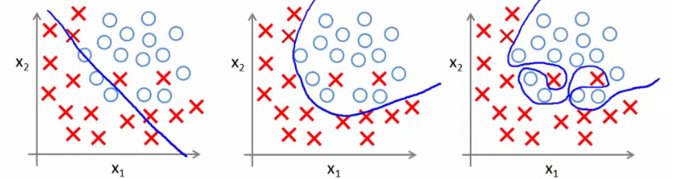
Failure to generalise: overfitting problem
Model is too simple
(underfitting)
Good fit to training data
And good generalisation
Overly complex model
(overfitting)
Getting good performance on training set but failing to generalise to test set

Slide 38
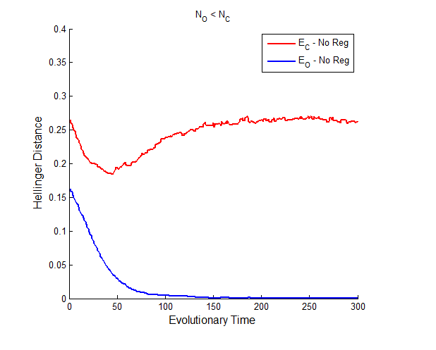
Improving fit to novel environments
Evolving in a random subset of selective environments drawn from a more general class
Kostas Kouvaris
But GRN doesnt produce phenotypes that are fit for the general class of selective environments
Distance between true class and set produced by the network
Easy to get perfect match to the set of selective environments you been evolved in

Slide 40
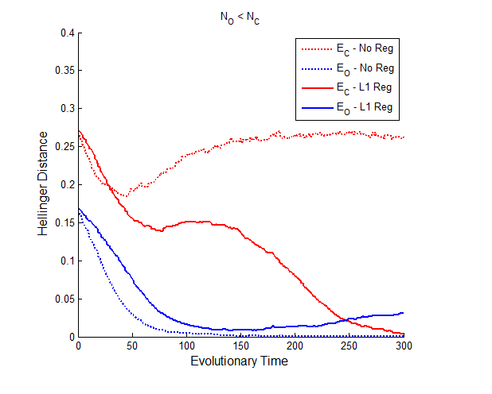
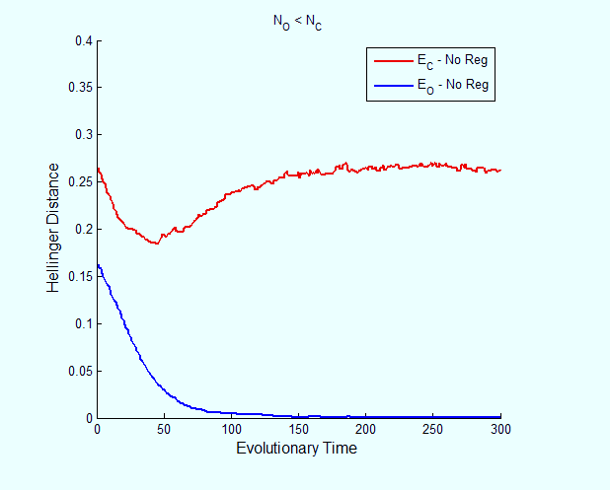
Improving fit to novel environments
Evolving in a random subset of selective environments drawn from a more general class
Kostas Kouvaris
Add selective pressure for sparse networks
Distance between true class and set produced by the network
Ability to cope with unseen environments improves dramatically
Fit to previously seen environments is slightly compromised

Slide 41
Conclusions part 2 (of 3)
Natural selection, like any basic learning system, has a tendency to over-fit – to memorise good phenotypes in a way that doesn’t generalise well. Selection in variable environments may result in flexibility w/o generalisation.
The conditions that alleviate overfitting in machine learning are predictive of conditions that alleviate this condition in evolutionary systems.
E.g. if connections are costly, natural selection evolves ‘models of’ fit phenotypes that represent key structural regularities (only) and thereby can produce other novel phenotypes that (are superficially very different from anything seen before, but) share these structural properties. i.e re-use past experience in a generative manner

Slide 42
3. From generalised variability to evolvability
Loizos Kounios
If an evolved GRN can be predisposed to produce novel combinations of features …
Are there conditions where that ability will bias evolutionary trajectories in useful ways – to facilitate adaptation?
Wagner already showed it can evolve same phenotypes faster – likewise Uri Alon. And Alon showed some generalisation…so can that generalisation enable evolution of new fitter phenotypes? (not just quicker but better)

Slide 43
In a multi-peaked fitness landscape, if a G–P map changes the regions of phenotype space that are explored, this may change the fitness peak that natural selection finds in the long term.
evolution over a fixed set of possible mutations given one G-P map quickly exhausts the production of beneficial variations and becomes trapped at a local optimum in the adaptive landscape
Nonetheless evolution over the same set of possible mutations with a different G-P map continues to produce adaptive variations that ultimately lead to superior regions of phenotype space

Slide 44
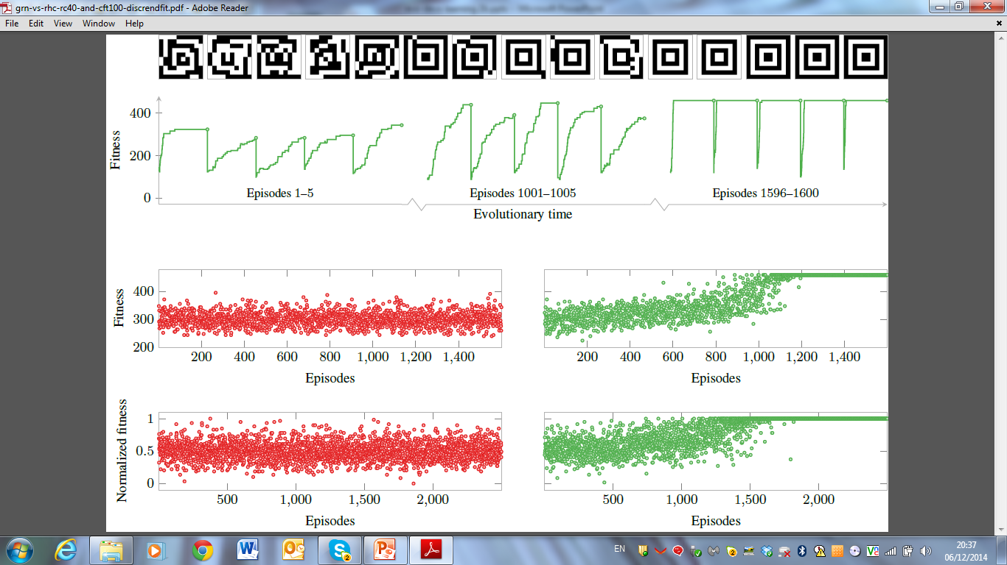
‘Target’ phenotype
10x10 image = 100 genes
Lots of sign-epistasis → a fitness landscape with many local optima (where local regions of the phenotype agree with the image).

Slide 45
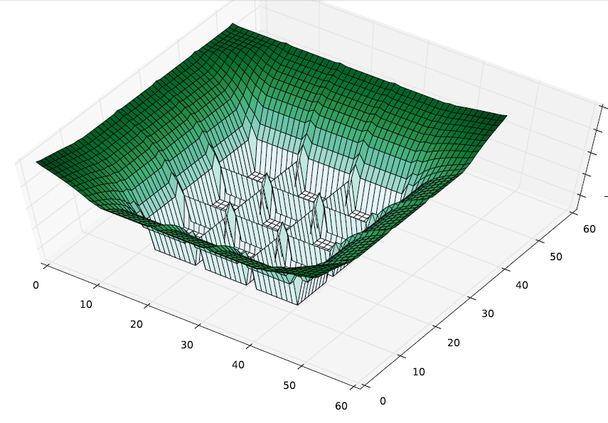

Slide 46
A micro-evolutionary trajectory using original GRN (i.e. a 1:1 G-P map) finds locally optimal phenotype

Slide 47
Micro-evolutionary trajectories starting from different points find different locally optimal phenotypes

Slide 48
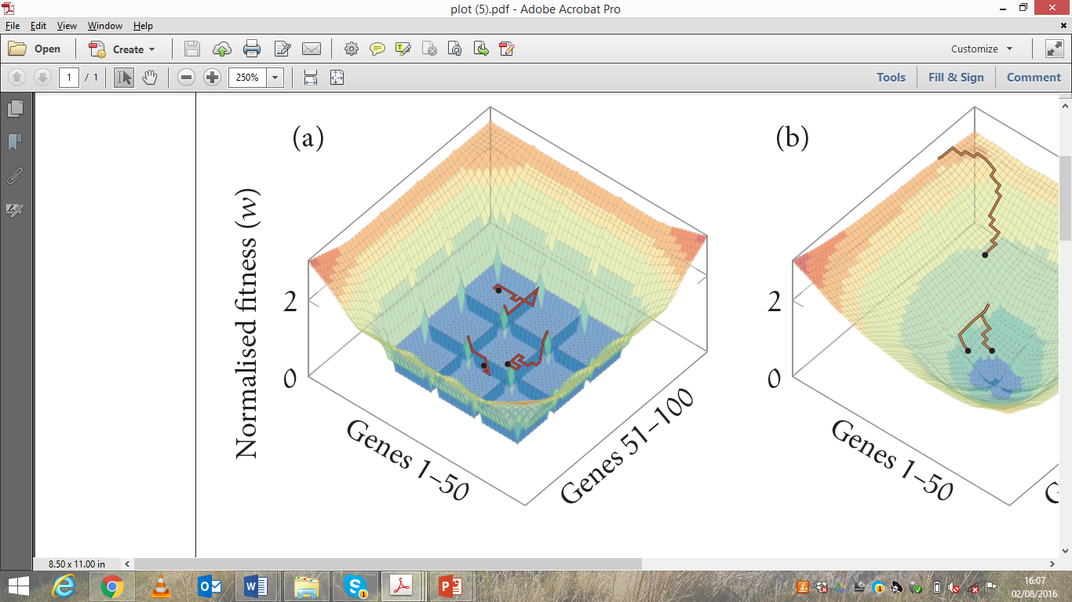

Slide 50
Each phenotype found is a ‘training pattern’ to the evolving GRN. It cant remember all of them – but it can remember what’s common to them – underlying structural regularities

Slide 51
As GRN evolves, it biases evolutionary trajectories to recreate those regularities

Slide 52
Eventually, evolved GRN causes evolution to find a maximally fit phenotype every time

Slide 53
memory facilitates adaptation
Fitness at end of each episode
Evolutionary time (episodes)
Because it doesn’t just recreate the past, it creates generalisations of it

Slide 54
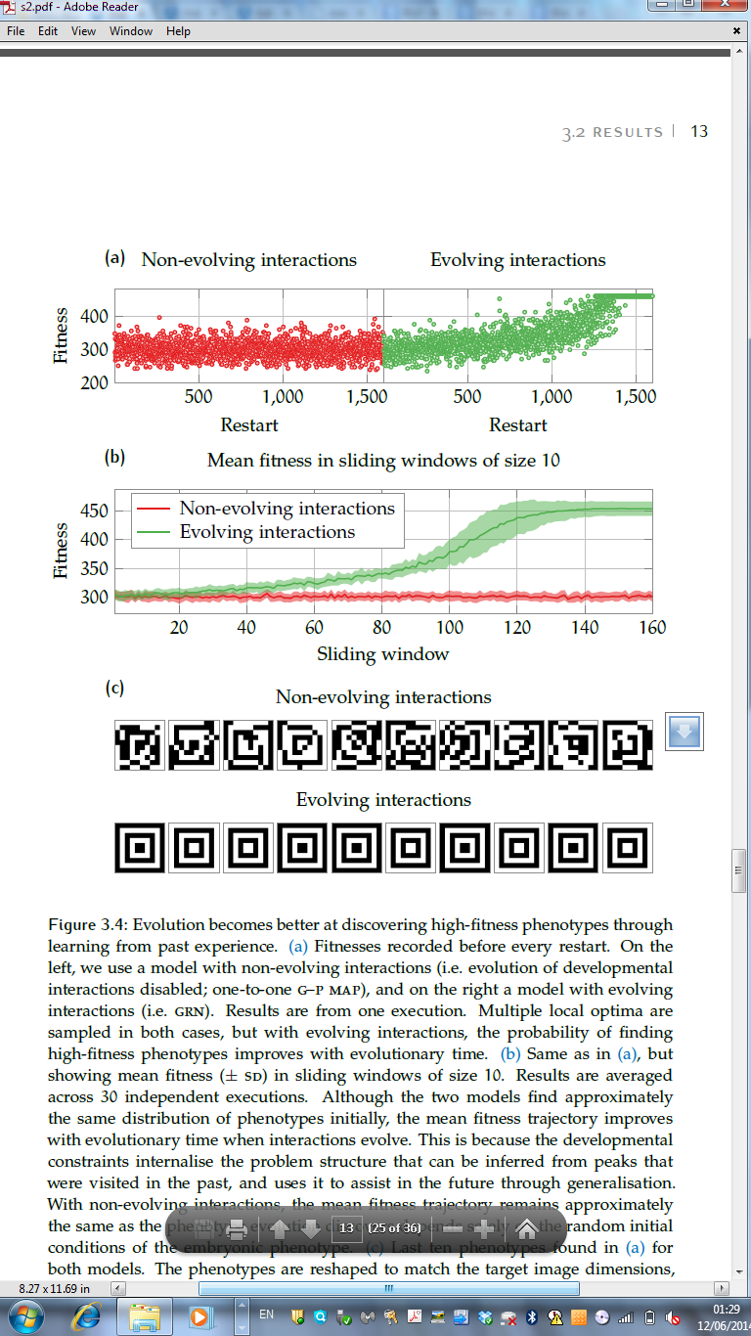
Example phenotypes evolved w and w/o evolved GP map
Example phenotypes evolved with evolved GP map
Fitnesses of locally optimal phenotypes found
Loizos Kounios
Deep evolutionary time (episodes)
Example phenotypes evolved with ~one-to-one GP map

Slide 55
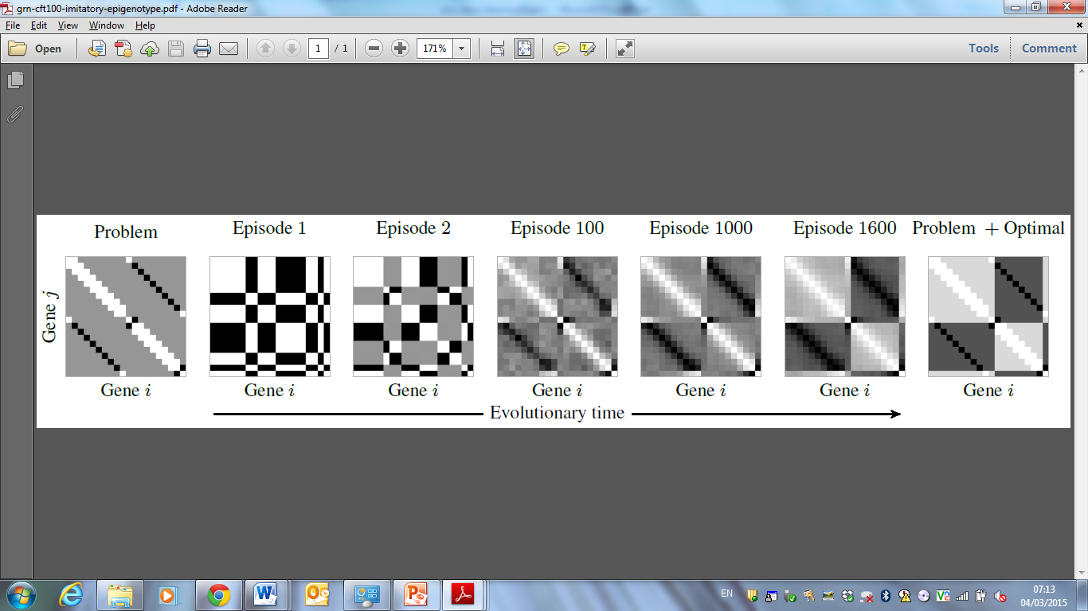
Riedl (1977) – the imitatory epigenotype
the evolution of complex organisms is facilitated by developmental architectures that are organised by natural selection to “mimic” or “imitate” the functional constraints on phenotypes
Evolved regulatory interactions have same structure as the epistasis in the problem

Slide 56
Riedl (1977) – the imitatory epigenotype
the evolution of complex organisms is facilitated by developmental architectures that are organised by natural selection to “mimic” or “imitate” the functional constraints on phenotypes
Plus… structure of the optimal solution by generalisation

Slide 57
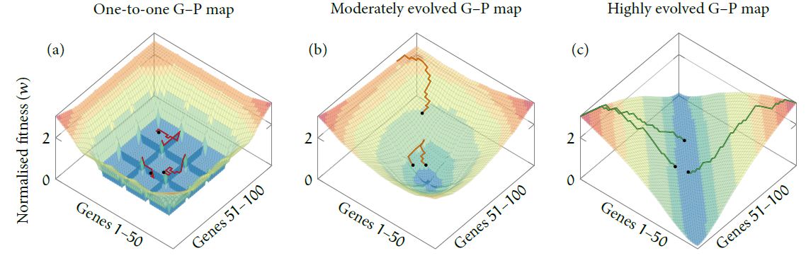
The phenotypic fitness landscape changes over deep evolutionary time

Slide 58
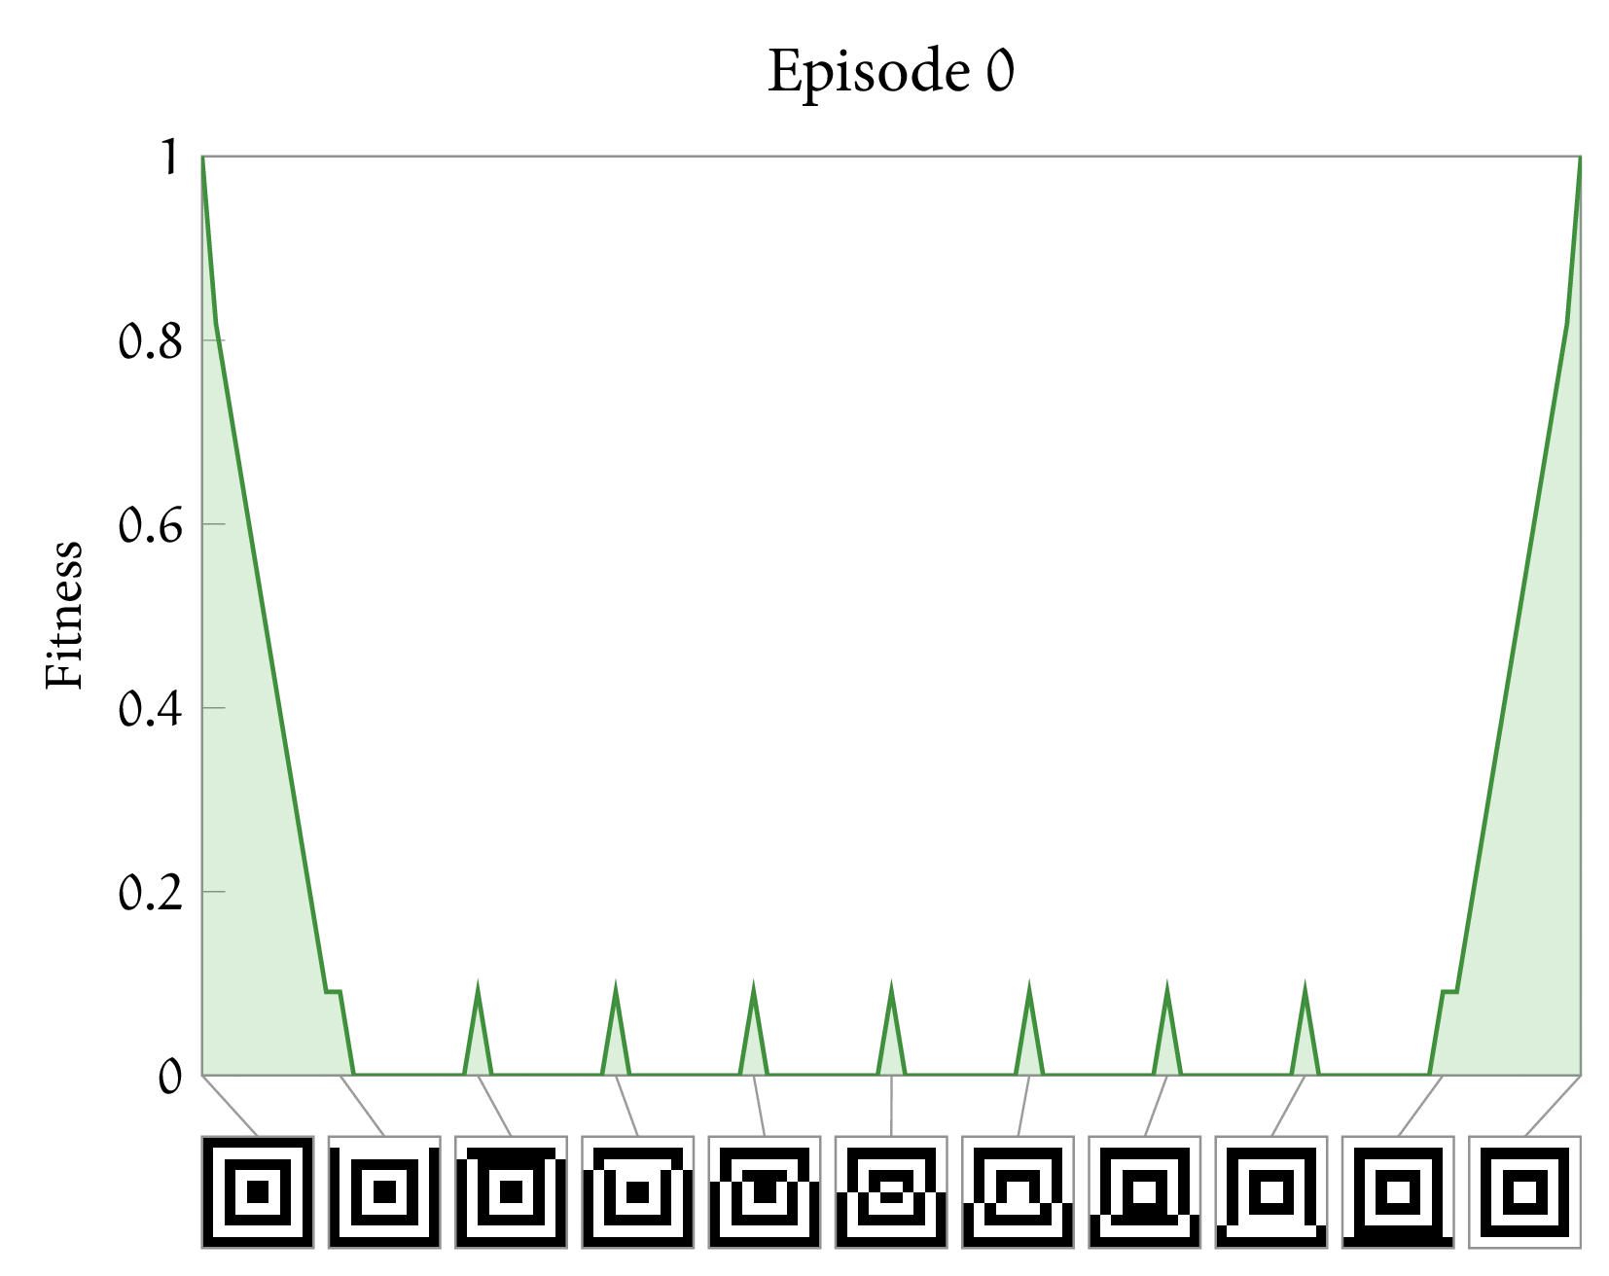

Regulatory interactions evolve to supress/amplify trait combinations that conflict/agree with high fitness phenotypes

Slide 59
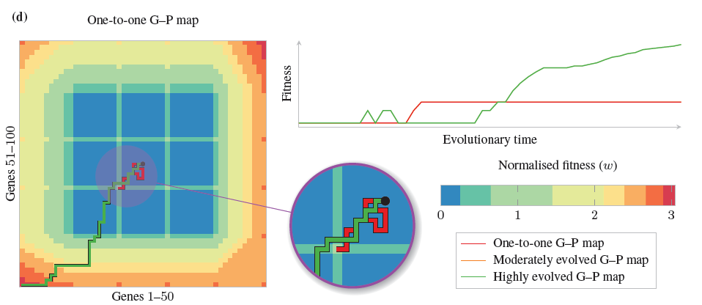
start
global optimum
Evolution w evolved mapping mutations that move closer to global optimum even though these same mutations would have been deleterious in the one-to-one map
Evolution w direct encoding is stuck

Slide 60
It accepts some mutations that would have been deleterious, and ignores some mutations that would have been beneficial, to get closer to G.O.
It does it by changing the phenotypic effects of mutations such that deleterious mutations going toward the GO are less deleterious and beneficial mutations going away from the GO are less beneficial. In short, mutations that reduce the distance to the GO are always beneficial in the new map.
Evolution with the highly evolved GP map acts ‘as if’ it has forethought (not short-sighted). But really its generalised recall of stuff its already seen.
Does not merely recall past phenotypes but also novel ones from same class

Slide 61
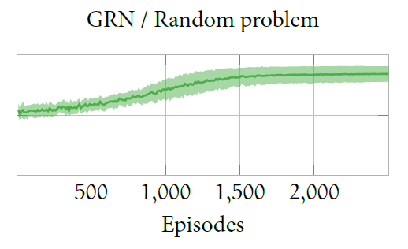
nothing special about this landscape
Same result occurs with landscapes defined by random pairwise epistasis
Random pairwise epistasis ≠ random landscape; there is still structure that can be learnt

Slide 62
Conclusions part 3 (of 3)
The ability of natural selection to generalise causes it to form developmental attractors that produce novel phenotypes
ie phenotypes that are not the same as any phenotype that’s been previously selected, but are new combinations of good features (common across many such phenotypes)
This enables it to ‘learn’ to evolve better over time, avoiding locally optimal phenotypes and finding fitter phenotypes that are otherwise unevolvable

Slide 63
summary
1. Evolution of constraints and biases can cause development to recreate multiple (significantly distinct) phenotypes that have been selected for in the past
2. …and generate novel phenotypes – not selected in the past, but from the same structural class – e.g. new combinations of features
3. …and thereby ‘learn’ how to evolve faster and better… how to generate novel phenotypes that are more likely to be fit, or lead to fit phenotypes → facilitated variation
memory
generalisation
learning

Slide 64
Resolving paradox of evolvability
Evolution of phenotypic distributions well-suited to future environments (via myopic process of ENS in past environments)…
…is no more mysterious than generalisation to an unseen test set from a limited training set
Its not mysterious, (inductive learning is not impossible)
but its not for granted either - we understand the conditions where it works/fails.
And we can use learning theory to understand the conditions for the evolution of evolvability

Slide 65
Other expansions of evolutionary theory using different types of learning theory
The evolution of
Developmental interactions /evolvability (evo-devo)
Ecological interactions (evo-eco)
Reproductive interactions /individuality (“evo-ego”)
✓

Slide 66
The evolution of environmentally-sensitive phenotypic plasticity
genetic correlations between plastic phenotypic responses
A lot of the same ideas apply as in evo-devo
‘Phenotype-first’ adaptation – c.f. canalisation or genetic assimilation of initially-plastic phenotypes
≈ Unsupervised correlation learning (Hebbian learning)
Not directed by fitness improvements that change the phenotype, but by fitness improvements that reinforce the existing phenotype
Existing phenotypes are not already adapted – but learning correlations in a set of them reduces space of possibilities, and can facilitate adaptation nonetheless

Slide 67
The evolution of ecological interactions
Fitness interactions between multiple evolution entities (rather than within one evolutionary entity)
Tends to reinforce existing combinations of species (already present in dynamics of the system) → we can understand what individual selection does to ecosystems using knowledge of unsupervised correlation learning
Not expected in general to increase social welfare (sum of individual welfare). But, when individual fitness is function of many low-order fitness interactions, total welfare and existing combinations will be positively correlated – and individual selection increases system ability to maximise social welfare over time.
Ecosystem can ‘learn’ to solve Sudoku puzzles (Dan Power)
Power, D., Watson, R.A., Szathmary, E., Mills, R., Powers, S.T., Doncaster, C.P., Czapp, B. (Biology Direct) What can ecosystems learn? Expanding evolutionary ecology with learning theory. Biology Direct. (also arXiv:1506.06374)

Slide 68
The evolution of individuality
Reproductive interactions between multiple evolution entities (changing the level at which fitness differences are heritable). Tends to reinforce existing combinations of species (already present in dynamics of the system) ≈ unsupervised correlation learning (again)
But, change in level of selection creates supervised learning at the next level of organisation.
Suggests ‘deep evolution’ (major transitions in evolution) implements a multi-scale associative learning machine, or ‘deep optimisation’ (Mills et al.) exploiting principles of deep learning (Hinton 2007)
Mills, R., Jansen, T. & Watson, R.A. (2014) Transforming Evolutionary Search into Higher-Level Evolutionary Search by Capturing Problem Structure. IEEE Trans. on Evolutionary Comp. 18(5) 628-642.
Watson, R.A. & Szathmary, E. (2016) “How Can Evolution Learn?” Trends in Ecology and Evolution.
Watson, R.A. et al. (2015) Evolutionary Connectionism: Algorithmic Principles Underlying the Evolution of Biological Organisation in Evo-Devo, Evo-Eco and Evolutionary Transitions, Evolutionary Biology.

Slide 69
Thanks to
Louis Kounios
Kostas Kouvaris
Gunter Wagner
Rob Mills
Chris Buckley
Eörs Szathmáry
Daniel Weinreich
Michaela Pavlicev
Tobias Uller

Slide 71
Good evolvability = avoiding overfitting
The difficulty of evolving evolvability is analogous to overfitting – getting phenotypic distributions that are well suited to novel selective environments (not canalised to past selective environments)
Getting good performance on the training set is the easy part of learning, the difficult part is getting good performance on the test set ➔ evolution is much easier than evolution of evolvability

Slide 72
All combinations of well-formed features

Slide 73
Select for 3 particular combinations of well-formed features

Slide 74
Evolved GRN produces…
the 3 selected phenotypes, plus some other combinations of well-formed features, but not all 16

Slide 75
Regulation that controls correlations…
Also produces complementary phenotypes w all the same correlations
Not an interesting sense of generalisation

Slide 76
Regulation that controls correlations…
Also produces complementary phenotypes w all the same correlations
Not an interesting sense of generalisation

Slide 77
The simplistic analogy
Evolution and learning are both types of adaptation
Evolution is a process of incremental improvement, trial and error, random variation and selective retention in a population
Trial and error is also a simple type of learning, random variation and selective retention in a brain (entertaining a ‘population’ of ideas/hypotheses in your head)
Both can be seen as mechanisms of improving the fit of an individual or a behaviour to an environment (on different timescales)

Slide 78
Basics of a formal analogy (for simplistic cases)
Evolution | learning
a genotype in a population | a hypothesis/belief about the world
the proportions of genotypes in a population | relative confidences in truth of those hypotheses
change in frequency of a genotype under natural selection in an environment | change in confidence in a hypothesis given evidence

Slide 79
Extending the scope of the analogy
Could smarter types of learning models be useful for understanding problematic areas of evolutionary theory?
Feedbacks between an adaptive process, its task environment and internal model are very well characterised in machine learning
Can this be used to characterise biological feedbacks between
Interaction of evolution and development
Interaction of evolution and ecology
Interaction of selection on existing evolutionary units and evolution of new evolutionary units

Slide 80
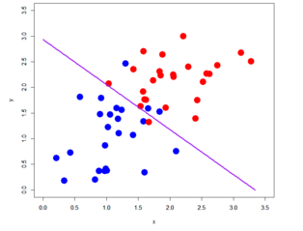
generalisation

Slide 81
generalisation
Linear combination model: ((x/3.5)+(y/3.0) > 1 ) → RED

Slide 82
Predictions from associative learning
neural networks | gene networks
1. Neurons that fire together wire together. | genes that are selected together wire together.
2. Distributed associative memory. (i.e. ability to store patterns of activation in the organisation of synaptic connections and recall patterns via activation dynamics) | Ability to store multiple past phenotypes in the organisation of interactions between genes and recall these states via gene expression dynamics.
3. Recall of a stored pattern from a partial stimulus. | Recreating a full phenotypic pattern from partially similar embryonic conditions.
4. Recognition or categorical perception of an input. | Switch-like phenotypic response to incremental changes in genetic input.
Watson, R. A., et al. (2014).. Evolution.

Slide 83
Adv. predictions from associative learning
neural networks | gene networks
5. Generalisation: generate patterns that are novel but from the same class (not nec. adjacent in feature space) | Development pre-disposed to produce phenotypes that are novel but from the same class as phenotypes selected in the past (not neighbours in trait space)
6. Improve constraint solving ability with experience | Evolve faster and find fitter phenotypes more reliably over evolutionary time

